Slide 1
Binary Basics and Boolean Algebra
Braidan Duffy
Master’s Ocean Engineering, 2023

Slide 2
Binary Basics
Why 1+1=10

Slide 3
Introduction
0 = Off, false
1 = On, true
0000 0000
128
64
32
16
8
4
2
1
Foundation of all digital electronics. Can be added, multiplied, compared, and converted
Bit
Nibble
Byte

Slide 4


Differentiation from Decimal
Decimal
(Base10)
Binary
(Base2)
$$20=2×{10}^{1}$$
$$450=4×{10}^{2}+5×{10}^{1}$$
$$245683=2×{10}^{5}+4×{10}^{4}+5×{10}^{3}+…$$
$${20}_{10}=2^{4}+2^{2}=0001 {0010}_{2}$$
$${450}_{10}=2^{8}+2^{7}+2^{6}+2^{1}=0001 1100 {0010}_{2}$$
$${245683}_{10}=2^{17}+2^{16}+2^{15}+…=0011 1011 1111 1011 {0011}_{2}$$
100,000,000
0000 0000
100M
10M
1M
100k
10k
1000
100
10
1
128
64
32
16
8
4
2
1

Slide 5



Binary Arithmetic - Addition
Binary numbers are added in same algorithm as decimal numbers
$$7+11=18$$
$$9+3=12$$
$$10+5=15$$
¹ | 0¹ | 1¹ | 1¹ | 1
+ | 1 | 0 | 1 | 1
1 | 0 | 0 | 1 | 0
 | 1 | 0¹ | 0¹ | 1
+ | 0 | 0 | 1 | 1
 | 1 | 1 | 0 | 0
 | 1 | 0 | 1 | 0
+ | 0 | 1 | 0 | 1
 | 1 | 1 | 1 | 1

Slide 6
Binary Arithmetic - Subtraction
Binary numbers are subtracted using a two’s complement
 |  |  |  | 2 | 4
- |  |  |  |  | 7
 | 1 | 1 | 0 | 0 | 0
- | 0 | 0 | 1 | 1 | 1
Flip subtrahend and add 1;
Change math to addition
 | 1 | 1 | 0 | 0 | 0
+ | 1 | 1 | 1 | 0 | 1
 |  |  |  | 1 | 7
1 | 1 | 0 | 0 | 0 | 1

Slide 7

Binary Arithmetic - Multiplication
Binary numbers are multiplied in same algorithm as decimal numbers
$$14×3=42$$
 | 1 | 1 | 1 | 0
* | 0 | 0 | 1 | 1
 | 1 | 1 | 1 | 0
 | 1 | 1 | 1 | 0
 | 0 | 0 | 0 | 0
+ | 0 | 0 | 0 | 0
0 | 1 | 0 | 1 | 0 | 1 | 0

Slide 8


















Binary Arithmetic - Division
Binary numbers are divided in same algorithm as decimal numbers
$$0$$
$$0$$
$$0$$
$$1$$
$$0$$
$$1$$
$$1$$
$$1$$
$$0011 \sqrt{01000101}$$
$$69÷3=23$$
$$−11$$
$$101$$
$$−11$$
$$0100$$
$$−11$$
$$11$$
$$−11$$
$$0$$

Slide 9
Logical Basics
Let’s Think About This, Shall We?

Slide 10
Truth Tables
Input 4 | Input 3 | Input 2 | Input 1 | Output
0 | 0 | 0 | 0 | X
0 | 0 | 0 | 1 | X
0 | 0 | 1 | 0 | X
0 | 0 | 1 | 1 | X
0 | 1 | 0 | 0 | X
0 | 1 | 0 | 1 | X
0 | 1 | 1 | 0 | X
0 | 1 | 1 | 1 | X
1 | 0 | 0 | 0 | X
1 | 0 | 0 | 1 | X
1 | 0 | 1 | 0 | X
1 | 0 | 1 | 1 | X
1 | 1 | 0 | 0 | X
1 | 1 | 0 | 1 | X
1 | 1 | 1 | 0 | X
1 | 1 | 1 | 1 | X
Truth tables are a representation of all possible inputs and their corresponding outputs
Follows a binary pattern
Can quickly show how certain inputs can generate expected outputs
Can also identify logical flaws in a design’s logic

Slide 11
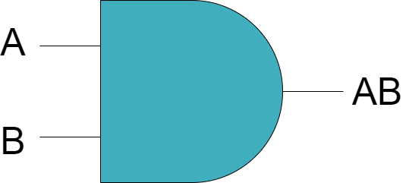
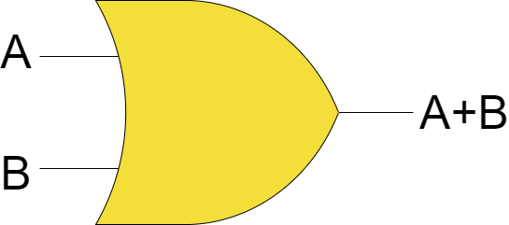
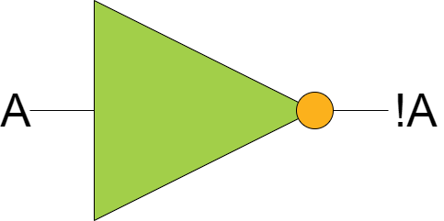



Basic Logic Operations
AND
$$Q=A⋅B$$
OR
$$Q=A+B$$
NOT
$$Q=\overline{A}$$
A | B | Q
0 | 0 | 0
0 | 1 | 0
1 | 0 | 0
1 | 1 | 1
A | B | Q
0 | 0 | 0
0 | 1 | 0
1 | 0 | 0
1 | 1 | 1
A | Q
0 | 1
1 | 0

Slide 12
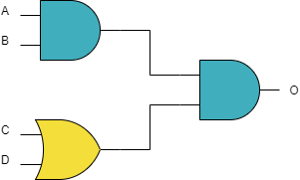

Basic Logic Operations - Example
A | B | C | D | O
0 | 0 | 0 | 0
0 | 0 | 0 | 1
0 | 0 | 1 | 0
0 | 0 | 1 | 1
0 | 1 | 0 | 0
0 | 1 | 0 | 1
0 | 1 | 1 | 0
0 | 1 | 1 | 1
1 | 0 | 0 | 0
1 | 0 | 0 | 1
1 | 0 | 1 | 0
1 | 0 | 1 | 1
1 | 1 | 0 | 0
1 | 1 | 0 | 1
1 | 1 | 1 | 0
1 | 1 | 1 | 1
1
1
1
$$O=\left(A⋅B\right)⋅(C+D)$$

Slide 13
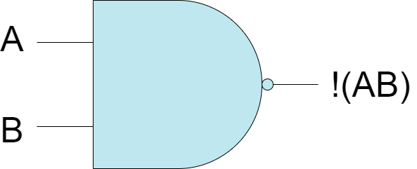
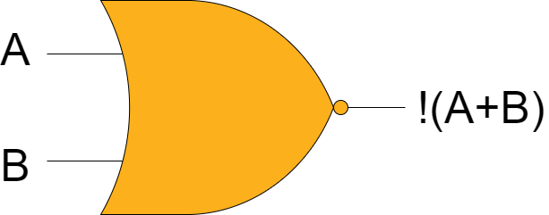
Combination Logic Operations
NAND
NOR
A | B | Q
0 | 0 | 1
0 | 1 | 1
1 | 0 | 1
1 | 1 | 0
A | B | Q
0 | 0 | 1
0 | 1 | 0
1 | 0 | 0
1 | 1 | 0

Slide 14
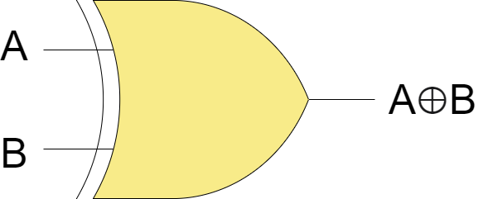
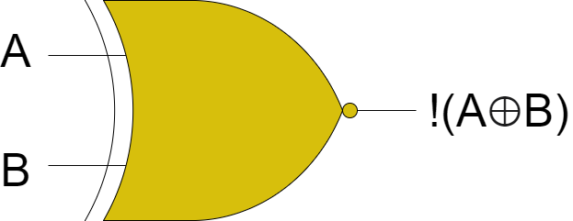


Advanced Logic Operations
XOR
$$Q=A⊕B$$
XNOR
$$Q=\overline{A⊕B}$$
A | B | Q
0 | 0 | 0
0 | 1 | 1
1 | 0 | 1
1 | 1 | 0
A | B | Q
0 | 0 | 0
0 | 1 | 1
1 | 0 | 1
1 | 1 | 0

Slide 15
Boolean Algebra

Slide 16


Introduction
Basic Expressions
$A+A=A$
$A⋅A=A$
$A+\overline{A}=1$
$A⋅\overline{A}=0$
$\overline{\overline{A}}=A$
Properties
AND: Communitive
OR: Communitive
NOT: Associative
$\overline{(AB)}≠(\overline{A}\overline{B})$

Slide 17
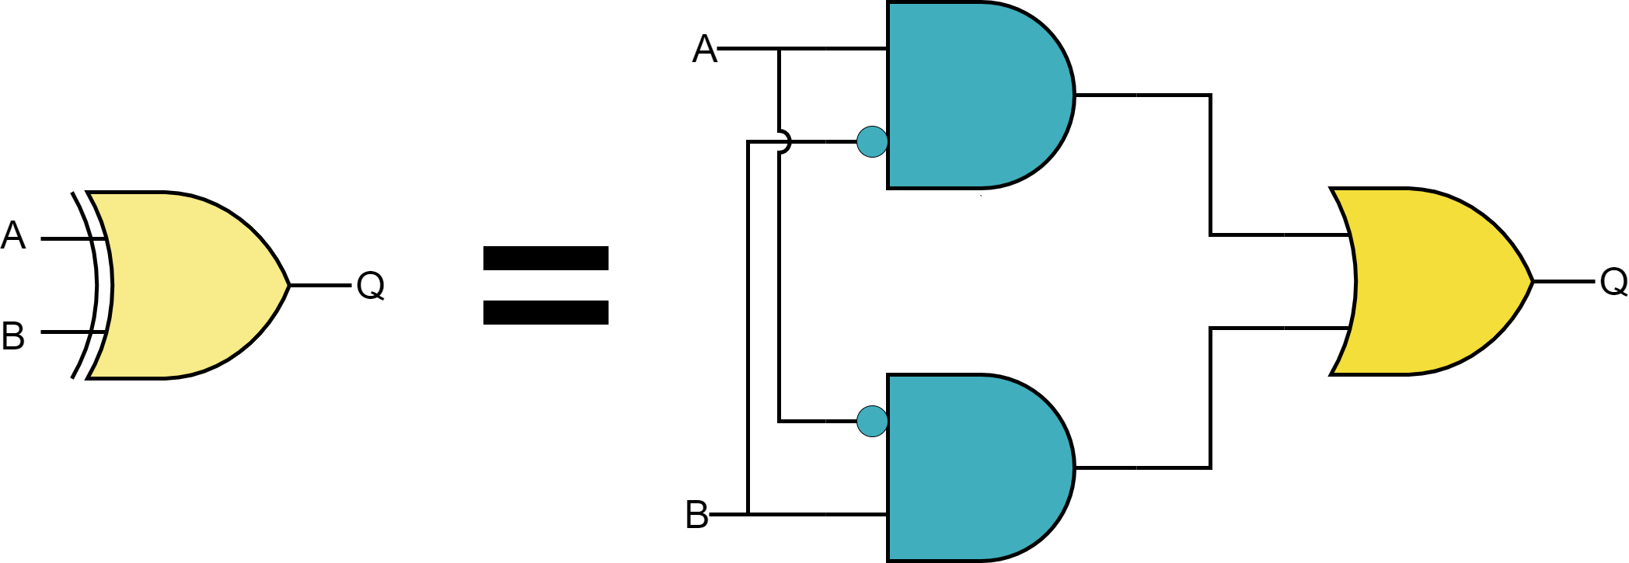

Gate Equivalency
A | B | Q
0 | 0 | 0
0 | 1 | 1
1 | 0 | 1
1 | 1 | 0
$$Q=\left(A⋅\overline{B}\right)+(\overline{A}⋅B)$$

Slide 18



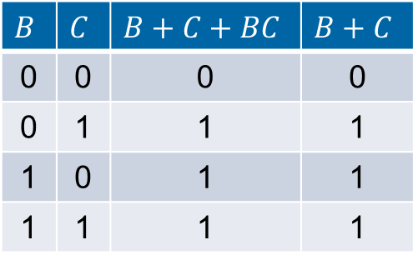

Logical Optimization
D | C | B | A | Q
0 | 0 | 0 | 0 | 1
0 | 0 | 0 | 1 | 1
0 | 0 | 1 | 0
0 | 0 | 1 | 1 | 1
0 | 1 | 0 | 0
0 | 1 | 0 | 1 | 1
0 | 1 | 1 | 0
0 | 1 | 1 | 1
1 | 0 | 0 | 0 | 1
1 | 0 | 0 | 1 | 1
1 | 0 | 1 | 0
1 | 0 | 1 | 1 | 1
1 | 1 | 0 | 0
1 | 1 | 0 | 1
1 | 1 | 1 | 0
1 | 1 | 1 | 1 | 1
$$Q=\overline{ABCD}+C+A+AC+AB+ABD+ABC+ABCD$$
$=\overline{ABCD}+ABCD+C+A(1+C+B+BD+BC)$
$=C+A(1+C+B+BD)$
$=C+A+AC+AB+ABD$
Recall: $\overline{A}+A=1$
$$B$$ | $$C$$ | $$B+C+BC$$ | $$B+C$$
0 | 0 | 0 | 0
0 | 1 | 1 | 1
1 | 0 | 1 | 1
1 | 1 | 1 | 1
$Q=C+A+AB+ABD$
But we can do better than this!

Slide 19

Logical Optimization – Karnaugh Maps
Notice: Only one bit change at a time!
Simplified representation of a truth table
Condenses all combinations into 4x4 grid
Groupings that are powers of two can be combined and simplified
Limited to a maximum of four variables!
AB CD | 00 | 01 | 11 | 10
00 | 1 |  |  | 1
01
11 | 1 | 1 | 1 | 1
10 | 1 |  |  | 1
1 |  |  | 1
1 | 1 | 1 | 1
1 |  |  | 1
1 | 1 | 1 | 1
$$Q=\overline{ABCD}+C+A+AC+AB+ABD+ABC+ABCD$$
$$Q=AB+(\overline{B}⋅\overline{D})$$

Slide 20
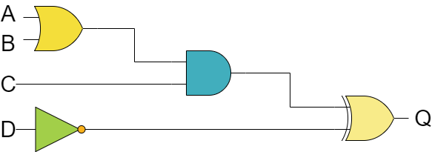

Logical Optimization - Example
$$Q=\left(A+B\right)⋅C⊕\overline{D}$$

Slide 21


Logical Optimization - Example
A | B | C | D | Q
0 | 0 | 0 | 0
0 | 0 | 0 | 1 | 1
0 | 0 | 1 | 0
0 | 0 | 1 | 1
0 | 1 | 0 | 0
0 | 1 | 0 | 1 | 1
0 | 1 | 1 | 0 | 1
0 | 1 | 1 | 1
1 | 0 | 0 | 0
1 | 0 | 0 | 1 | 1
1 | 0 | 1 | 0 | 1
1 | 0 | 1 | 1
1 | 1 | 0 | 0
1 | 1 | 0 | 1 | 1
1 | 1 | 1 | 0 | 1
1 | 1 | 1 | 1
$$Q=\left(A+B\right)⋅C⊕\overline{D}$$
AB CD | 00 | 01 | 11 | 10
00
01 | 1 | 1 | 1 | 1
11
10 |  | 1 | 1 | 1
1 | 1 | 1 | 1
1 | 1
1 | 1
$$Q=\overline{C}D+BC\overline{D}+AC\overline{D}$$

Slide 22
Thank You! Questions?

